Slide 1
Hostel Management System
Presented By: charvi Upadhyay, Divya kavdia, neha Chouhan,
Preeti Kushwaha, Tehlil khan

Slide 2
Introduction
Hostel Management System is a customized and user-friendly software for Hostel which provides hostel information, hostel room information, and hostel accounts information.
It helps admin to manage:
Student record
Staff record
Generating student and staff report.

Slide 3
Objectives
To replace the existing system which is much more time consuming.
To provide quick and efficient means for gathering the student information along with their rooms, fees of student and then finally check-in and checkout of student.
To generate reports on hostel occupancy and financial reports.

Slide 4
Existing System
Requires a lot of time as well as manpower to manage register system.
It is very difficult to maintain or update all the record and retrieve certain data.

Slide 5
Scope
All the details related to a hosteller could be find in one place like the admission details, fees details, room details, attendance, mess details, stipend details etc.
Will make the monitoring of student and stock details easy.
The same application could be used by both the account section and the hostel management for their specific needs and purposes.
This project enable user to store all the data in a database.
We can keep backup in external storage, so that it is fully secured.

Slide 6
Features of HMS
High security.
Data redundancy can be avoided.
Easy to handle, update and keep record.
Backup data can be easily generated.

Slide 7
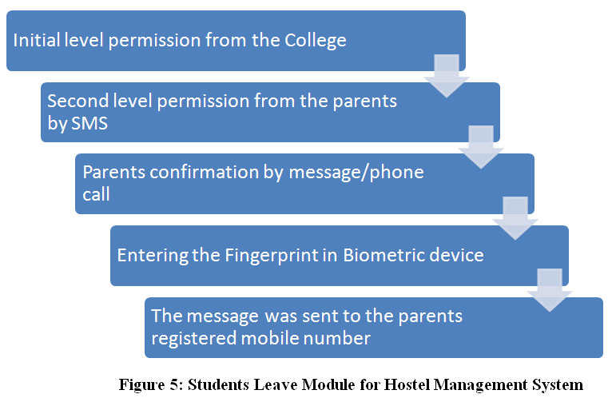
Methodology Developmental Model

Slide 8
Modules of HMS
Student module
Staff module
Salary module
Room and fee module

Slide 9
Hardware Requirements
Processor: Pentium
RAM: 512 MB
Hard Disk: 160 GB
Monitor
Keyboard

Slide 10
Software Requirements
Language: Frontend(HTML, CSS,Javascript), Frameworks(ReactJS)
Backend(PHP), Libraries(NodeJS)
Operating System: Windows 10
Software: Visual Studio 2013
Database: SQL Server 2008, MongoDB

Slide 11
Feasibility Study
Technical feasibility
Economic feasibility
Operational feasibility of the project.

Slide 12
Testing
Testing is the process of running a system with the intention of finding errors.
Testing enhances the integrity of the system by detecting deviations in designs and errors in the system.

Slide 13
Steps of Testing
Unit testing
Integration testing
Validation testing
Output testing
User Acceptance testing

Slide 14
Data Collection Methods
Data collection methods or fact gathering techniques which are used while gathering the information about Hostel Management System, they are:
Interviewing
Record inspection
Observation

Slide 15
Delimitations
All the data are held in a single computer, it does not involve the internet.
This system is designed for school level hostels further we can upgrade this software for college and university.

Slide 16
Expected Output
All the details related to the hosteller could be finding in one place like the admission details, fees details, room details, attendance, message details, student details etc.
Useful for monitoring and keeping record of the student.
Generate reports on the hostel occupancy.

Slide 17
THANK YOU

